Slide 1


Artificial Intelligence (Machine Learning & Deep Learning)
NAVTCC & Strings Technologies
by Salman Ahmad

Slide 2
Outline Week 3 Day 1 & 2
Correlation Coefficient
1
2
Univariate, bivariate and multivariate plots
Probability
3
4
Joint, Marginal and Conditional probability
Probability Distributions
5
6
Discrete and Continuous probability
distributions
Bayesian Probability
7

Slide 3
Correlation Coefficient (Pearson’s r)
Measures the strength and direction of a linear relationship between two numeric variables.
Range: From -1 to +1
r = +1: Perfect positive correlation
As one variable increases, the other increases in a perfectly linear fashion.
r = 0: No linear correlation
Changes in one variable do not predict changes in the other.
r = -1: Perfect negative correlation
As one variable increases, the other decreases in a perfectly linear fashion.

Slide 4
Correlation Coefficient (Pearson’s r)
r Value | Strength | Direction
0.9 to 1.0 | Very Strong | Positive
0.7 to 0.9 | Strong | Positive
0.5 to 0.7 | Moderate | Positive
0.3 to 0.5 | Weak | Positive
0 to 0.3 | Very Weak | Positive
-0.3 to 0 | Very Weak | Negative
-0.5 to -0.3 | Weak | Negative
-0.7 to -0.5 | Moderate | Negative
-0.9 to -0.7 | Strong | Negative
-1.0 to -0.9 | Very Strong | Negative

Slide 5
Correlation Coefficient (Pearson’s r)
Using numpy: np.corrcoef
- Gives correlation matrix
- No p-value
Using scipy: scipy.stats.pearsonr
- Gives correlation coeffienct value
- gives p-value as well

Slide 6
Correlation Coefficient (Pearson’s r)
Correlation ≠ Causation: Just because two variables are correlated does not mean one causes the other.
Only captures linear relationships: Non-linear relationships may have r ≈ 0 but still be strongly related.
Sensitive to outliers: Extreme values can distort the correlation coefficient.

Slide 7
Correlation Coefficient (Pearson’s r)
Correlation ≠ Causation: Just because two variables are correlated does not mean one causes the other.
Only captures linear relationships: Non-linear relationships may have r ≈ 0 but still be strongly related.
Sensitive to outliers: Extreme values can distort the correlation coefficient.
Categorical Data: Pearson’s r requires interval or ratio scale variables (continuous numerical). It’s invalid for ordinal or nominal variables.

Slide 8
Correlation Coefficient (Pearson’s r)
Heteroscedasticity: Pearson assumes homoscedasticity (equal variance across values). If the variance differs widely across the range, the correlation becomes unreliable.
Alternatives When Pearson’s r Fails:
Spearman’s Rank Correlation – for monotonic but non-linear relationships.
Kendall’s Tau – more robust with small sample sizes or ordinal data.
Mutual Information – for capturing arbitrary relationships (including non-linear).

Slide 9
Probability
Probability measures the likelihood that a particular event will occur.
Values range from 0 (impossible) to 1 (certain).
P(E)=Total number of possible outcomes / Number of favorable outcomes​
Types of Probability
Theoretical Probability
Based on known possible outcomes (e.g., coin toss, dice roll).
Example: P(Heads) = ½

Slide 10
Probability
Types of Probability
Experimental (Empirical) Probability
Based on observed data or experiments.
Formula:
P(E)=Observed frequency of event / Total trials
Subjective Probability
Based on intuition, experience, or personal judgment.
Example: Chance of a startup succeeding.

Slide 11
Probability — Key Terminology
Sample Space (S): All possible outcomes.
E.g., For a dice roll: S = {1, 2, 3, 4, 5, 6}
Event (E): A subset of the sample space.
E.g., Rolling an even number: E = {2, 4, 6}
Complement (E′): Event not happening.
P(E′)=1−P(E)
Independent Events: One event does not affect the other.
P(A∩B)=P(A)×P(B)
Dependent Events: Events are linked; outcome of one affects the other.
Mutually Exclusive Events: Events that cannot occur at the same time.
P(A∪B)=P(A)+P(B)

Slide 12
Joint Probability
Aka Probability of the intersection of events
Probability of two events occurring together.
Notation:
P(A∩B) = P(A) * P(B) — A and B are independent events
P(A∩B) = P(A) * P( B ∣ A) — A and B are dependent events
Example:
P(Student is Male and studies Math)
Interpretation:
It measures how often two events happen simultaneously.

Slide 13
Conditional Probability
Probability of event A given that event B has occurred.
Notation:
P(A | B) – Probability of A given that B has occurred
P(B | A) – Probability of B given that A has occred
Formula:
P(A∣B) = P(A∩B) / P(B)
Example:
P(Student is Male given that they study Math)
Interpretation:
It shows how the occurrence of one event affects the probability of another.

Slide 14
Conditional Probability
 | Math | English | Total
Male | 30 | 10 | 40
Female | 20 | 40 | 60
Total | 50 | 50 | 100
Joint: P(Male ∩ Math) = 30 / 100 = 0.30
Marginal: P(Female) = 60 / 100 = 0.60
Conditional: P(Math | Male) = 30 / 40 = 0.75

Slide 15
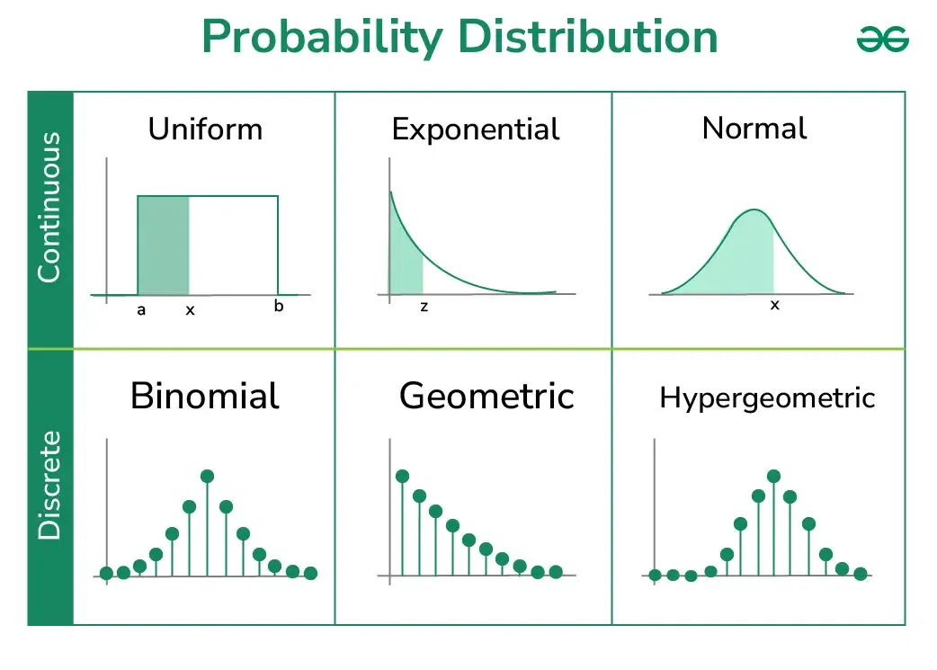
Probability Distribution
A probability distribution describes how probabilities are distributed over values of a random variable.
Two main types: Discrete and Continuous.
Helps us model uncertainty and make predictions.

Slide 16
Probability Distribution
A mathematical function that provides the probabilities of occurrence of different possible outcomes in an experiment.
Describes the likelihood of values a random variable can take.
Depends on whether the variable is discrete or continuous.

Slide 17
Discrete
Probability Distribution
Applies to countable outcomes (e.g., number of heads in coin tosses).
Each outcome has an associated probability.
Must satisfy:
0≤P(x)≤1
∑P(x)=1
Example: Binomial Distribution, Poisson Distribution

Slide 18
Continuous
Probability Distribution
Applies to uncountable outcomes (e.g., time, height, weight).
Described using a Probability Density Function (PDF).
Total area under the curve = 1.
Probability of exact value = 0; we calculate over intervals.
Example: Normal Distribution, Exponential Distribution

Slide 19
Probability Distribution – key terms
Random Variable: A variable whose values depend on outcomes of a random phenomenon.
Expected Value (Mean): Average value over many trials.
Variance & Standard Deviation: Measure of spread or variability.

Slide 20
Common Probability Distributions
Binomial Distribution: Fixed number of trials, success/failure outcomes.
Poisson Distribution: Counts of events in fixed intervals.
Normal Distribution: Bell-shaped, symmetric curve.
Uniform Distribution: All outcomes equally likely.
Exponential Distribution: Time between events in a Poisson process.

Slide 21
Bayesian Probability
Bayesian probability interprets probability as a degree of belief, updated as more evidence becomes available.
Based on Bayes' Theorem
Contrasts with frequentist interpretation (which uses long-run frequencies).
Widely used in AI, statistics, and decision-making.

Slide 22
Bayes’ Theorem – The Formula
P(A∣B) = (P(B∣A)⋅P(A)​) / P(B)
P(A∣B): Posterior (updated probability of A given B)
P(B∣A): Likelihood (how probable B is given A)
P(A): Prior (initial belief about A)
P(B): Evidence (probability of B under all hypotheses)

Slide 23
Bayes’ Theorem – The Formula
Intuition Behind Bayes' Theorem
Start with a prior belief about an event (P(A))
Gather new evidence or data (B)
Update your belief → posterior probability (P(A | B))
Real-world analogy:
A doctor has a belief (prior) about disease occurrence.
A test result (evidence) affects their updated belief (posterior).

Slide 24
Bayes’ Theorem – The Formula
Aspect | Bayesian | Frequentist
Probability meaning | Degree of belief | Long-run frequency
Prior knowledge | Used | Not used
Data interpretation | Updates belief with new data | Depends only on sample data
Flexibility | High (dynamic) | Rigid (static)

Slide 25
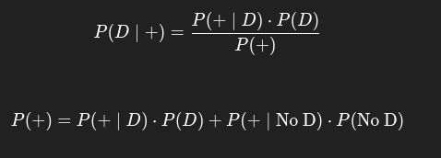

Bayes’ Theorem – The Formula
A Classic Example (Medical Test)
Disease prevalence: 1% → P(D)=0.01P
Test sensitivity: 99% → P(+∣D)=0.99
Test false positive rate: 5% → P(+∣No D)=0.05
Question: If someone tests positive, what’s the probability they actually have the disease?

Slide 26
Bayesian Probability
Applications of Bayesian Probability
Spam filtering (Naive Bayes)
Medical diagnosis
Machine learning (Bayesian networks, Bayesian inference)
Risk modeling
Forecasting and decision making
Limitations and Challenges
Requires specifying a prior (can be subjective)
Computational complexity in large models
Inference can be slow without approximation methods (e.g., MCMC)

Slide 27

Questions?
"He who asks a question is a fool for a minute; he who does not remains a fool forever." – Confucius

